Slide 1
N E H E M I A H

Slide 2
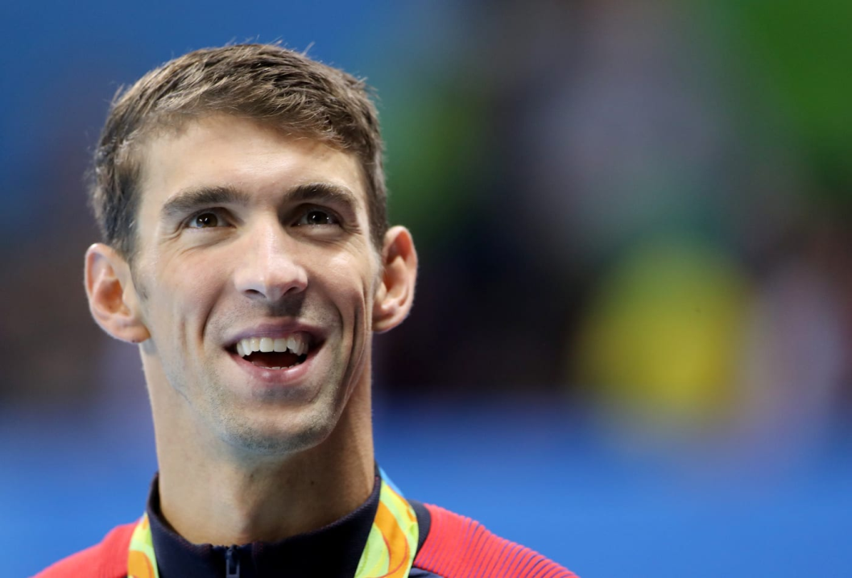
Michael Phelps

Slide 3
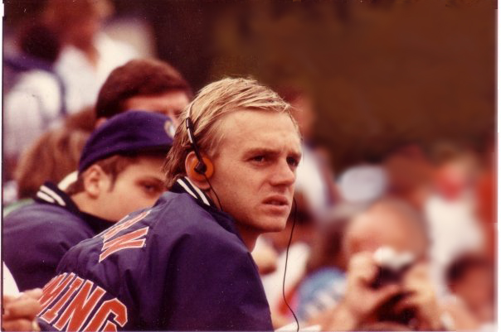
Rowdy Gaines

Slide 4
N E H E M I A H

Slide 5
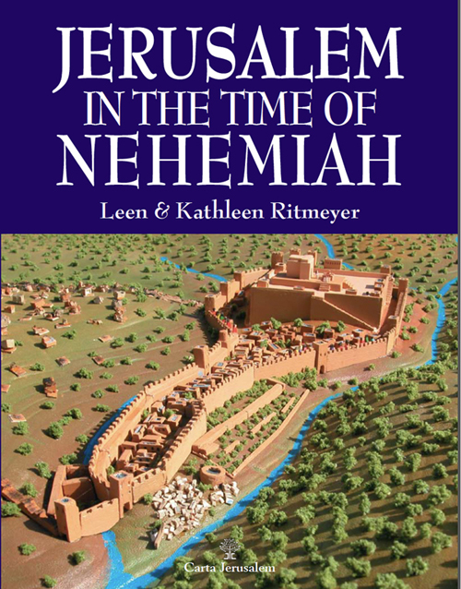

Slide 6
Eliashib the high priest and his fellow priests went to work and rebuilt the Sheep Gate…

Slide 7
Eliashib the high priest and his fellow priests went to work and rebuilt the Sheep Gate…
…and above the corner of the Sheep Gate the goldsmiths and merchants made repairs.

Slide 8
What kind of people are used by God to accomplish His mission?

Slide 9
Those who are willing, with a good attitude, to do their part.

Slide 10
The next section was repaired by the men of Tekoa, but their nobles would not put their shoulders to the work under their supervisors.
Nehemiah 3:5

Slide 11
Those who are willing, with a good attitude, to do their part.

Slide 12
Shallum son of Hallohesh, ruler of the half-district of Jerusalem, repaired the next section with the help of his daughters.
Nehemiah 3:12

Slide 13
The Dung Gate was repaired by Malkijah…
Nehemiah 3:14

Slide 14
Next to them, the men of Tekoa repaired another section, from the great projecting tower to the wall of Ophel.
Nehemiah 3:27

Slide 15
Those who value and work within a team.

Slide 17
Those who value and work within a team.

Slide 18
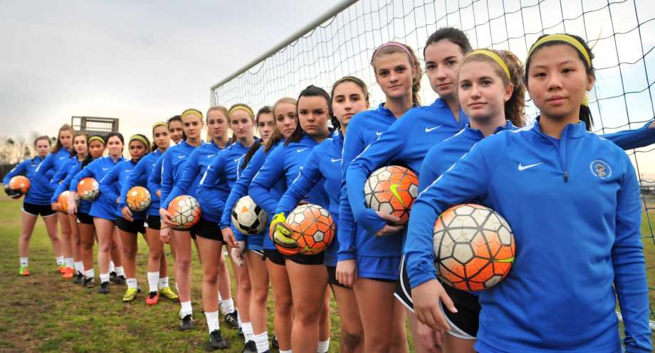

Slide 19
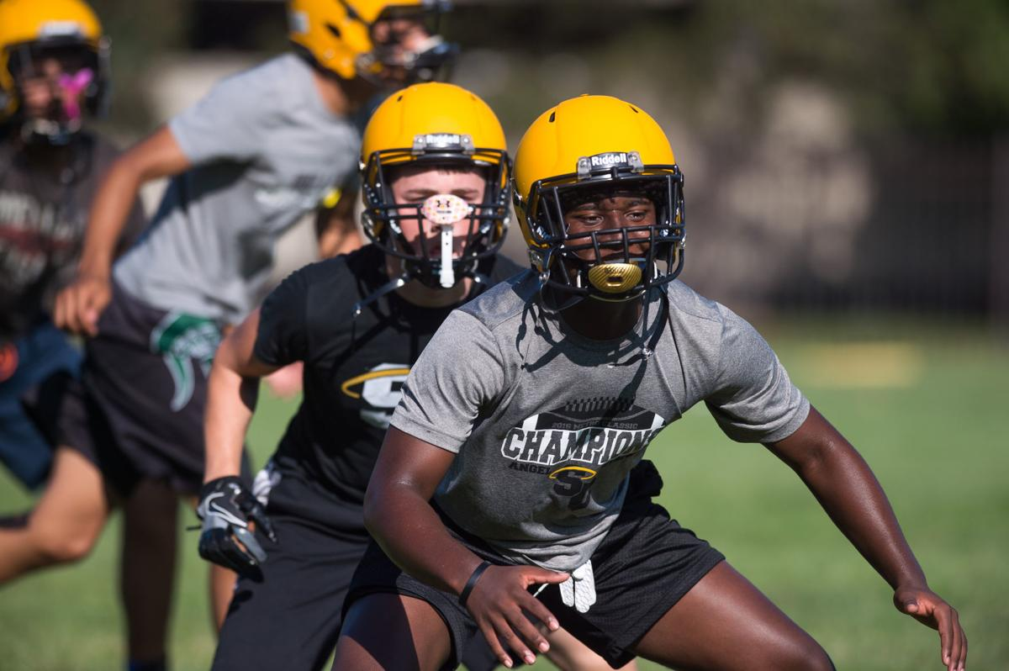

Slide 20
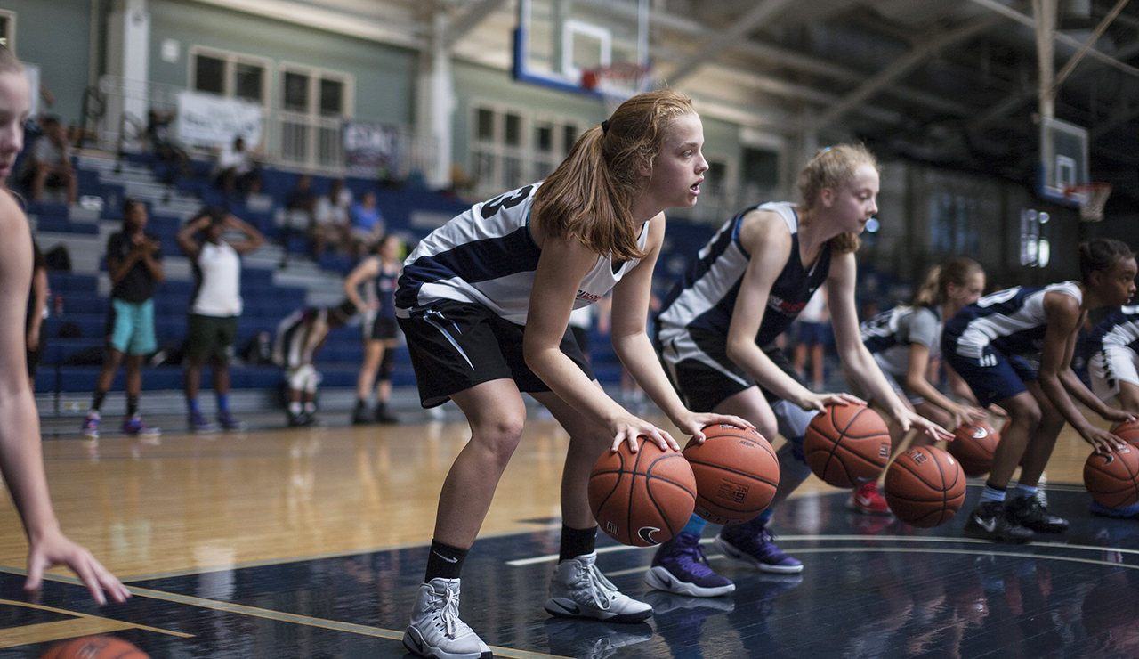

Slide 21
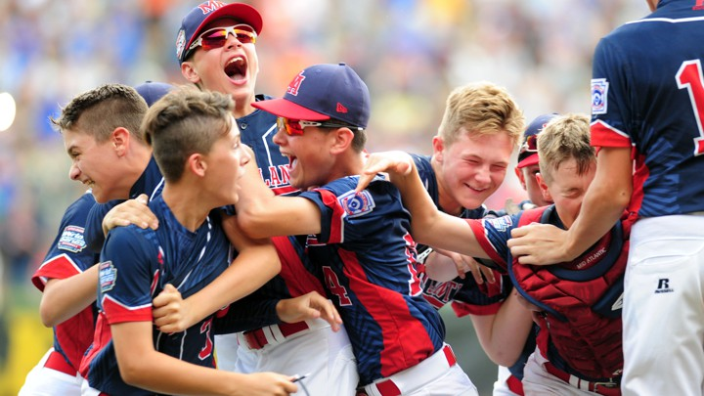

Slide 22
N E H E M I A H

Slide 24
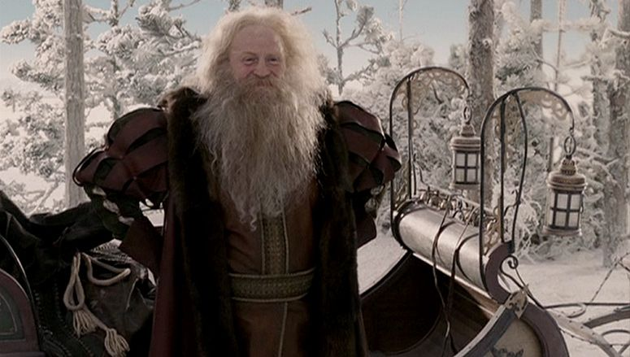

Slide 25
N E H E M I A H

