Slide 1
N E H E M I A H

Slide 3
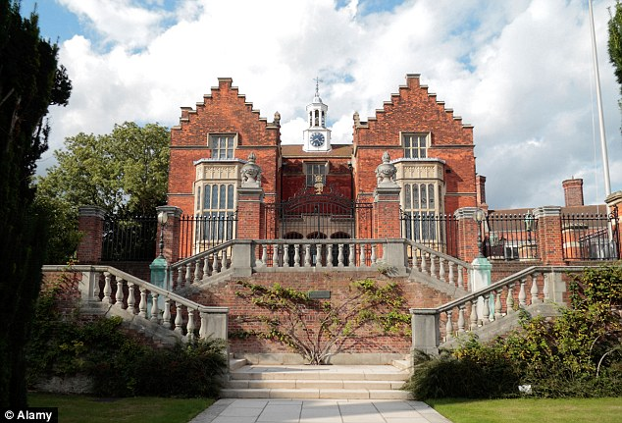

Slide 4
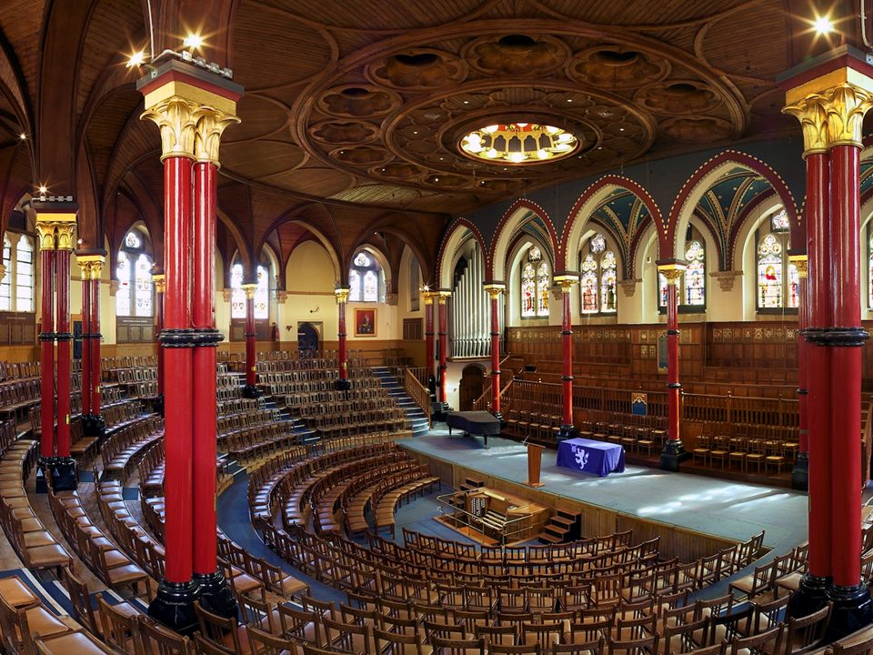

Slide 5
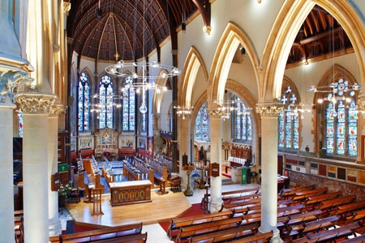

Slide 6
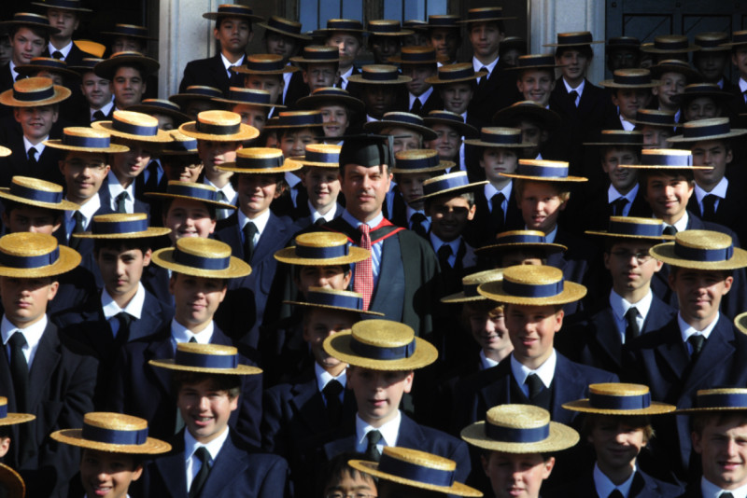

Slide 8
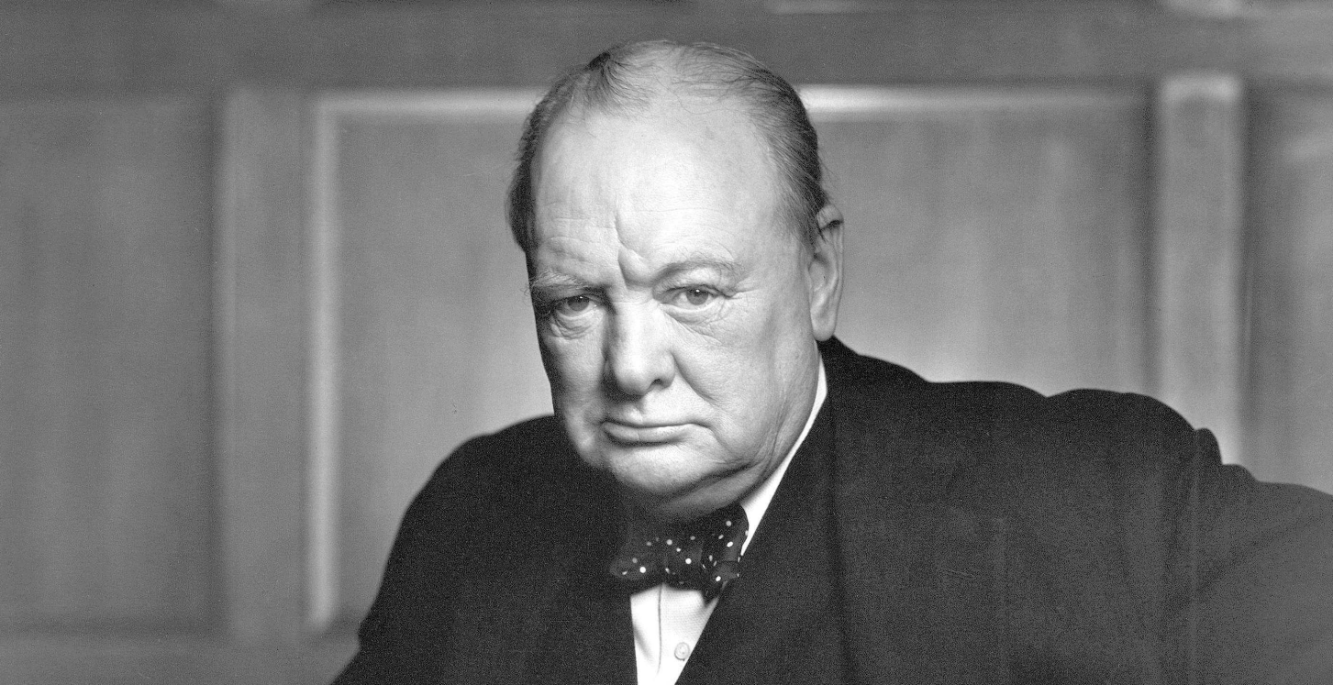
Winston Churchill
1874 - 1965

Slide 9
N E H E M I A H

Slide 10
What kind of people are used by God to accomplish His mission?

Slide 11
In the month of Nisan in the twentieth year of King Artaxerxes, when wine was brought for him, I took the wine and gave it to the king. I had not been sad in his presence before, so the king

Slide 12
asked me, “Why does your face look so sad when you are not ill? This can be nothing but sadness of heart.” I was very much afraid, but I said to the king, “May the king live forever!

Slide 13
Why should my face not look sad when the city where my ancestors are buried lies in ruins, and its gates have been destroyed by fire?” The king said to me, “What is it you want?” Then I prayed to

Slide 14
the God of heaven, and I answered the king, “If it pleases the king and if your servant has found favor in his sight, let him send me to the city of Judah where my ancestors are buried so that

Slide 15
I can rebuild it.” Then the king , with the queen sitting beside him, asked me, “How long will your journey take, and when will you get back?” It pleased the king to send me; so I set a time.

Slide 16
In order for Nehemiah to become a man of vision he had to become a man of courage.

Slide 17
Courage is not the absence of fear….

Slide 18
Courage is not the absence of fear…
Courage is acting in spite of your fear.

Slide 19
In order for Nehemiah to become a man of vision he had to become a man of courage.

Slide 20
In order for Nehemiah to become a man of vision he had to become of man of prayer and fasting.

Slide 21
In order for Nehemiah to become a man of vision he had to become of man who was willing to leave the life he knew.

Slide 22
James Boice
1938 - 2000

Slide 23
In order for Nehemiah to become a man of vision he had to become of man who was willing to leave the life he knew.

Slide 24
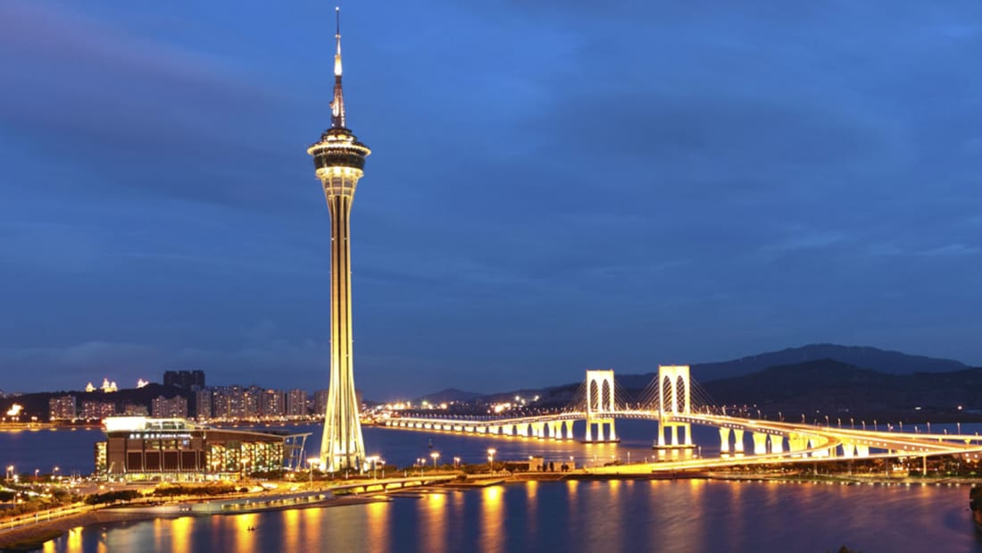
Macau Tower

Slide 25
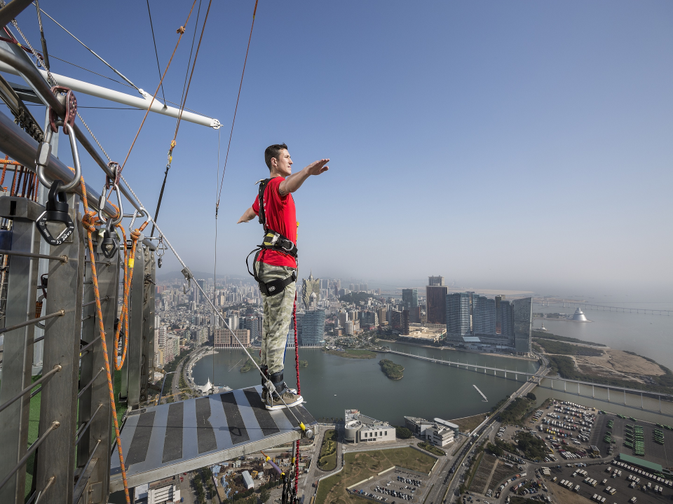

Slide 26
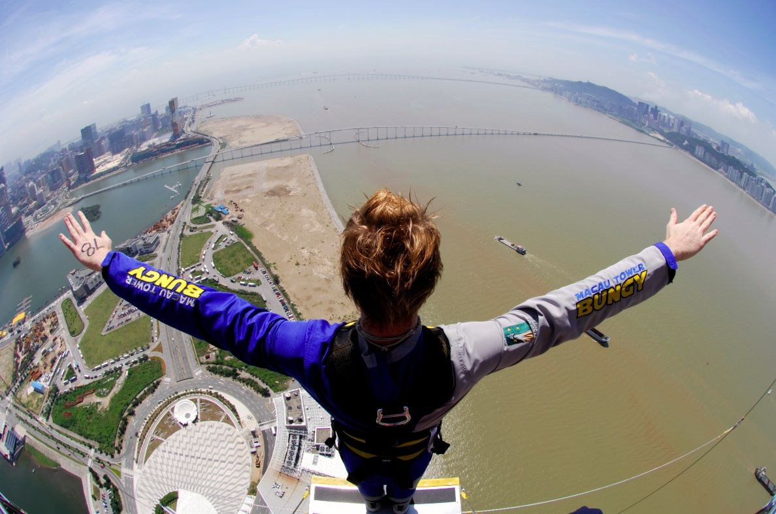

Slide 27
N E H E M I A H

