Slide 1
N E H E M I A H

Slide 2
I also said to him, “If it pleases the king, may I have letters to the governors of Trans-Euphrates, so that they will provide me safe-conduct until I arrive in Judah? And may I have a letter to Asaph, keeper of the royal park, so he will

Slide 3
give me timber to make beams for the gates of the citadel by the temple and for the city wall and for the residence I will occupy?” And because the gracious hand of my God was on me, the king granted my requests. So I went to the

Slide 4
governors of Trans-Euphrates and gave them the king’s letters. The king had also sent army officers and cavalry with me. When Sanballat the Horonite and Tobiah the Ammonite official heard about this, they were very much

Slide 5
disturbed that someone had come to promote the welfare of the Israelites.

Slide 6
N E H E M I A H

Slide 7
I went to Jerusalem, and after staying there three days Is et out during the night with a few others. I had not told anyone what my God had put in my heart to do for Jerusalem. There were no mounts with me except the one I was riding on.

Slide 8
By night I went out through the Valley Gate toward the Jackal Well and the Dung Gate, examining the walls of Jerusalem, which had been broken down, and its gates, which had been destroyed by fire. Then I moved on toward

Slide 9
the Fountain Gate and the King’s Pool, but there was not enough room for my mount to get through; so I went up the valley by night, examining the wall. Finally, I turned back and reentered through the Valley Gate. The officials did

Slide 10
not know where I had gone or what I was doing, because as yet I had said nothing to the Jews or the priests or nobles or officials or any others who would be doing the work. Then I said to them, “You see the trouble we are in:

Slide 11
Jerusalem lies in ruins, and its gates have been burned with fire. Come, let us rebuild the wall of Jerusalem, and we will no longer be in disgrace. I also told them about the gracious hand of my God on me and what the king had said to me.

Slide 12
They replied, “Let us start rebuilding.” So they began this good work. But when Sanballat the Horonite, Tobiah the Ammonite official and Geshem the Arab heard about it, they mocked and ridiculed us. “What is this

Slide 13
you are doing?” they asked. “Are you rebelling against the king?” I answered them by saying, “The God of heaven will give us success. We His servants will start rebuilding, but as for you, you have no share in Jerusalem or any claim or historic right to it.

Slide 14
Those who have God’s hand on them evaluate and address the broken walls around them.

Slide 15
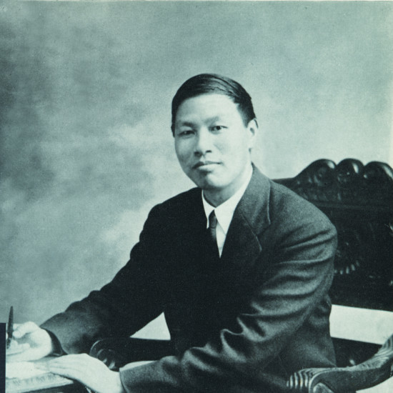
Watchman Nee
1903-1972

Slide 16
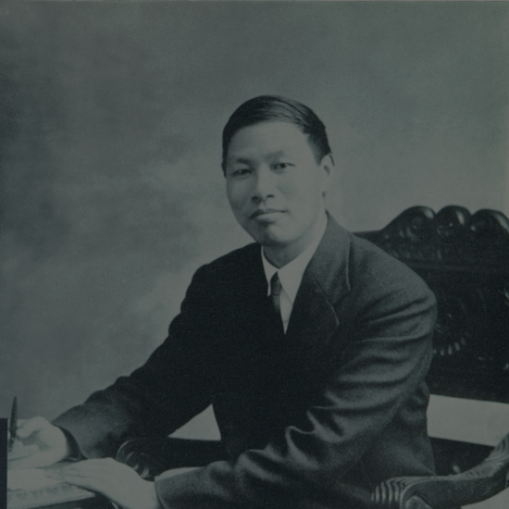
The burden of the spirit
vs.
The weight of the spirit

Slide 17
Those who have God’s hand on them evaluate and address the broken walls around them.

Slide 18
What are the broken walls in your life today?

Slide 19
What are the broken walls in your life today?
What are the broken walls in the church today?

Slide 20
Those who have God’s hand on them evaluate and address the broken walls around them.

Slide 21
Those who have God’s hand on them sound the alarm and rally others for the work.

Slide 22
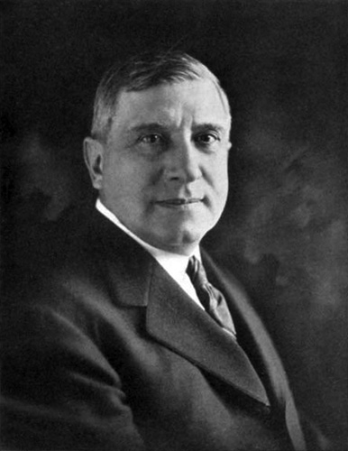
Charles
Schwab
1862 - 1939
Bethlehem Steel

Slide 23
If you want to win spirited men to your way of thinking, throw down a challenge.

Slide 24
Those who have God’s hand on them sound the alarm and rally others for the work.

Slide 25
Those who have God’s hand on them accept that opposition will always be a part of doing God’s work.

Slide 26
Watchman Nee
1903-1972

Slide 27
N E H E M I A H

